Slide 1

CSE 460: VLSI Design Lab Experiment 3: Blocking and Non-blocking Statements in Verilog

Slide 2



Concurrent Statements
In any HDL, concurrent statement means the code may include a number of statements and each represent a part of the circuit.
What concurrent means:
Concurrent is used because the statements are considered in parallel and the ordering of statements in the code doesn’t matter.
A
B
module full_add(S, Cout, A, B, Cin); // This module implements a 1-bit full adder input A, B, Cin; output S, Cout; assign S = A ^ B ^ Cin; assign Cout = (A & B) | (Cin & (A ^ B)); endmodule
Cout
Cin
full_add
S

Slide 3
Procedural Statements
These statements are inside always @() block.
The If-else statement:
always @(*)
begin
if(expression1)
begin
statement1;
end
else if(expression2)
begin
statement2;
end
else
begin
statement3;
end
end
If expression1 is True then the statement1 is evaluated.
If not , then the compiler will consider other expressions.
The else if and else clauses are optional.
When multiple statements are involved, they have to be included inside a begin-end block

Slide 4
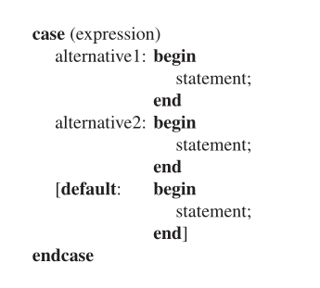
Procedural Statements
The case statement
The bits in expression are called the controlling expression.
Controlling expression are checked for a match with each alternative.
The first successful match causes the associated statements to be evaluated.
Default case evaluates only when no other alternative matches.

Slide 5
wire vs reg
Nets
- Nets represent connections between hardware elements. Nets are continuously driven by the outputs of the devices they are connected to.
- Nets are declared with the keyword wire. A net is assigned the value z by default.
Registers
- In verilog register means a variable that can hold a value. Unlike net, a register doesn’t need a driver.
- Registers are declared with the keyword reg. The default value of a reg data type is x.
wire a, b; // wire declaration
reg clock; // register declaration

Slide 6
wire vs reg
When to use which?
If a signal needs to be assigned inside an always block, it must be declared as a reg.
If a signal is assigned using a continuous assignment statement, it must be declared as a wire.
By default, module input and output ports are wires; if any output ports are assigned in an always block, they must be explicitly declared as reg: output reg <signal name>
How to know if a net represents a register or a wire?
A wire net always represents a combinational link
A reg net represents a wire if it is assigned in an always @ (*) block
A reg net represents a register if it is assigned in an always @ (posedge/negedge clock) block

Slide 7
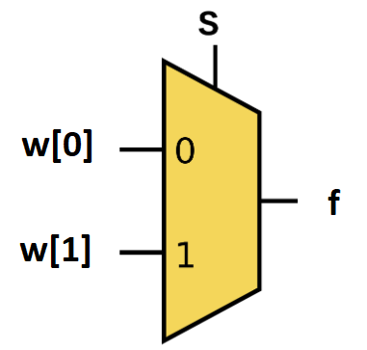
Procedural Statements
2 to 1 Mux:
When s=0, f = w[0] When s=1, f = w[1]

Slide 8
Procedural Statements
The If-else statement:
module mux2to1(w, S, f);
input S;
input [1:0]w;
output reg f;
always @(w, S) // always @(*)
begin
if(S == 0)
f = w[0];
else
f = w[1];
end
endmodule

Slide 9
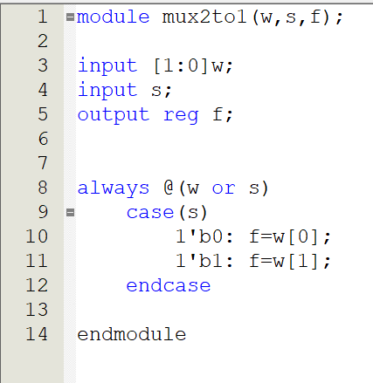
Procedural Statements
This is the code of 2 to 1 Mux using case statement.
The mux can have two possible outputs because “s” is only 1 bit.
Which is why the case statement has two alternatives.
We could have included a default case because “s” can also have values of “x” and “z”. But we will learn about them soon.
We can also use “1” as alternative instead of “1’b0”.
If a statement in an alternative has multiple line it must be included in Begin-end block.

Slide 10
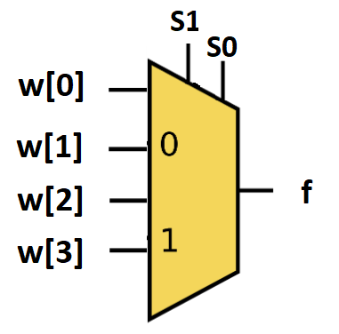
Procedural Statements
4 to 1 Mux:
00
When s=00, f = w[0] When s=01, f = w[1]
When s=10, f = w[2]
When s=11, f = w[3]
01
10
11

Slide 11
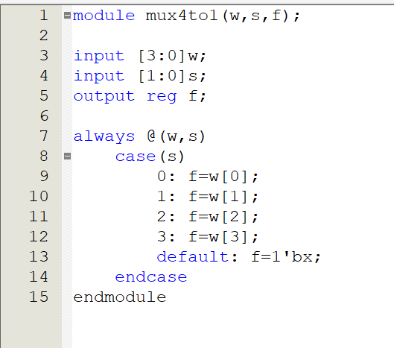
Procedural Statements
S | 00 | 01 | 10 | 11
f | W[0] | W[1] | W[2] | W[3]

Slide 12
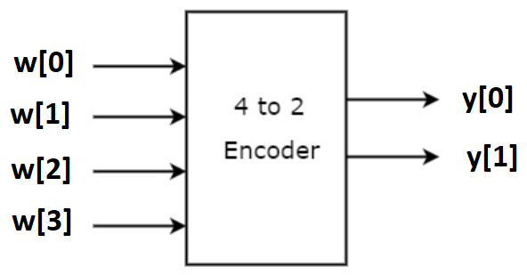
Procedural Statements
4 to 2 encoder (one-hot encoding):
Inputs |  |  |  | Outputs
w[3] | w[2] | w[1] | w[0] | y[1] | y[0]
0 | 0 | 0 | 1 | 0 | 0
0 | 0 | 1 | 0 | 0 | 1
0 | 1 | 0 | 0 | 1 | 0
1 | 0 | 0 | 0 | 1 | 1

Slide 13
Procedural Statements
4 to 2 priority encoder:
When multiple input lines are active high at the same time, the output is generated by the the input with the highest priority.
w[3] | w[2] | w[1] | w[0] | y[1] | y[0]
0 | 0 | 0 | 0 | X | X
0 | 0 | 0 | 1 | 0 | 0
0 | 0 | 1 | x | 0 | 1
0 | 1 | x | x | 1 | 0
1 | x | x | x | 1 | 1
For 3>2>1>0 priority:

Slide 14
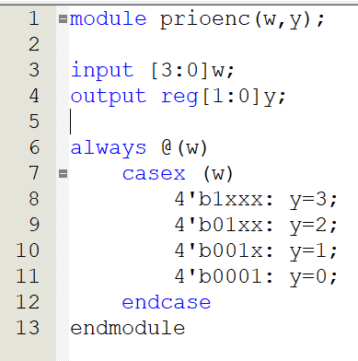
Procedural Statements
In the “case” statement , controlling bits can also have value of “x” and “z”.
The values of “x” and “z” are also checked for exact match with the same values in the controlling expressions.
The “casex” statement treats both “x” and “z” as don’t cares.
That means when they are present as input , code won’t check for their alternatives.
In the right there is a Verilog code of priority encoder with 4 bit input “w” and output “y”.
The first alternative “1xxx” specifies that if w[3] has the value of 1 , then the other inputs are treated as don’t cares and so the output is set to “y=3”

Slide 15
custom inputs, w=100011, 110000, 001000 for a 1>5>0>4>2>3 priority order encoder:
module Pencoder(y,w);
input [5:0]w;
output reg [2:0]y;
always@(w)
begin
casex(w)
6'bxxxx1x: y=1;
6'b1xxx0x: y=5;
6'b0xxx01: y=0;
6'b01xx00: y=4;
6'b00x100: y=2;
6'b001000: y=3;
endcase
end
endmodule
tutorial link:
https://youtu.be/54F7N2vncLY?feature=shared

Slide 16

Procedural Assignment Statements
A value is assigned to a variable with a procedural assignment statement.
There are two kinds of assignment statements.
Blocking assignments
Non-blocking assignments.
Blocking assignments are denoted by the “=“ symbol.
Blocking means that first the assignment statement completes and updates it’s left-hand side first.
This updated left-hand side value is then used for evaluation of subsequent statements.

Slide 17
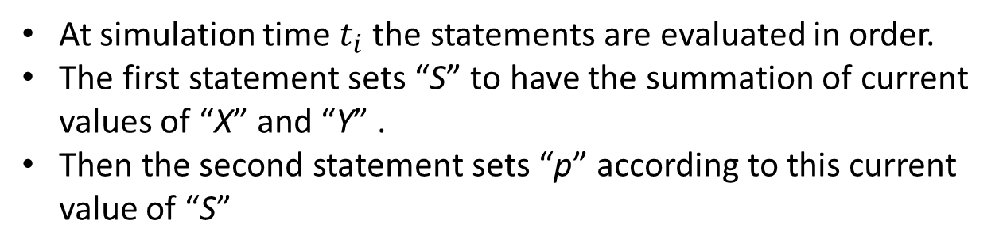
Procedural Assignment Statements

Slide 18
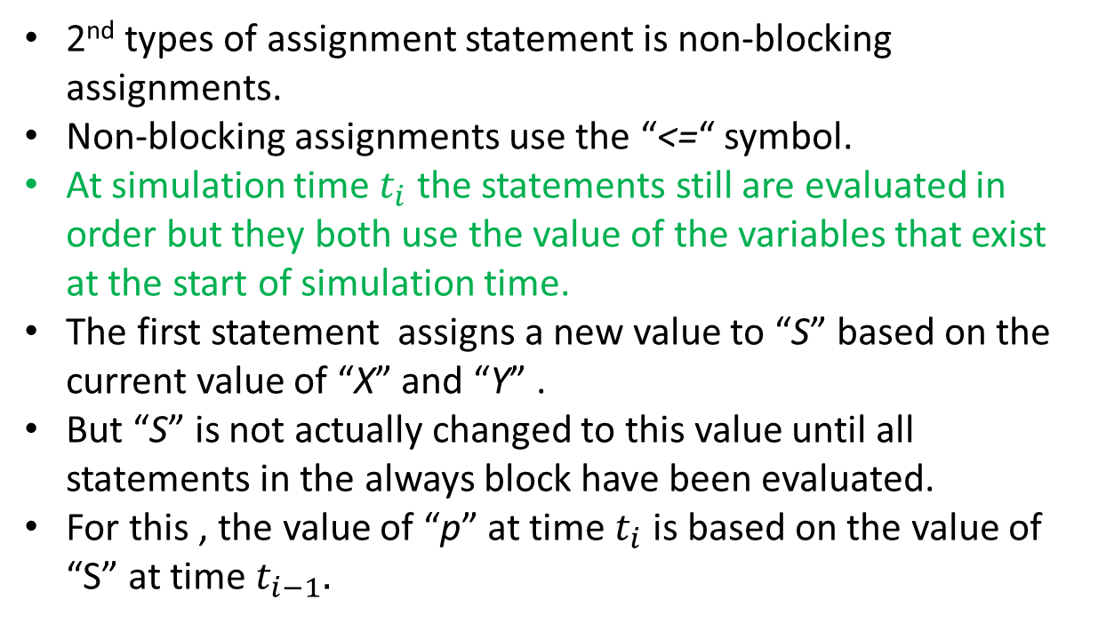

Procedural Assignment Statements

Slide 19
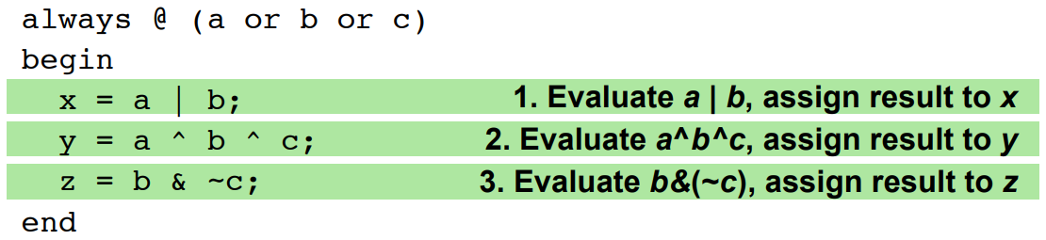
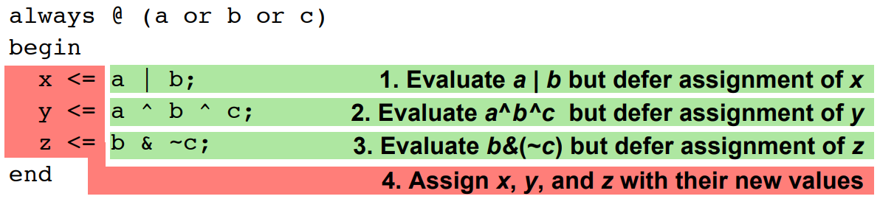
Blocking vs. Non-blocking assignments
Blocking assignment: evaluation and assignment are immediate
Nonblocking assignment: all assignments deferred until all right-hand sides have been evaluated (end of simulation timestep)

Slide 20
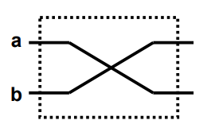
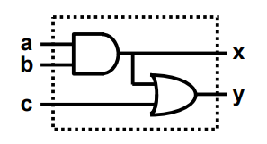
Why we need them?
Swapping a,b
X
✔
a = b
b = a
x = a & b
y = x | c
Blocking: Evaluation and assignment are immediate
Non-Blocking: Assignment is postponed until all r.h.s. evaluations are done
✔
X
a <= b
b <= a
x <= a & b
y <= x | c
When to use (inside always block)
Sequential Circuits
Combinational Circuits

Slide 21
Combinational vs. Sequential
A combinational circuit is one in which the output is independent of time and solely depends on the present input. Example: Encoder, Decoder, Multiplexer, Demultiplexer
A sequential circuit is one in which the output is dependent not only on the current input but also on the past ones. Examples: Flip-flops, counters.

Slide 22
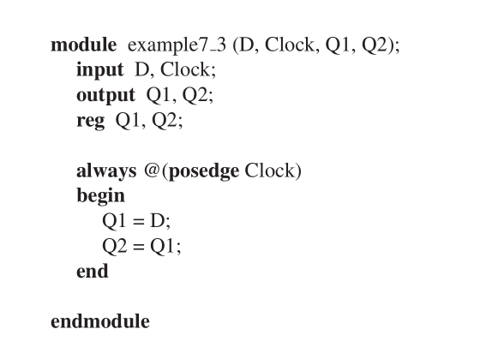
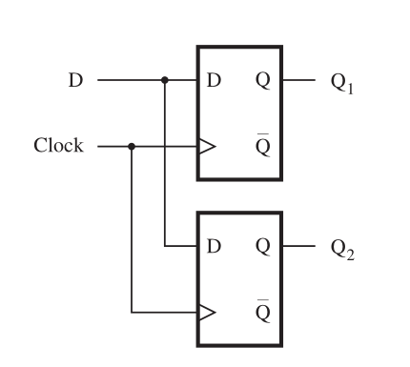
Procedural Assignment Statements

Slide 23
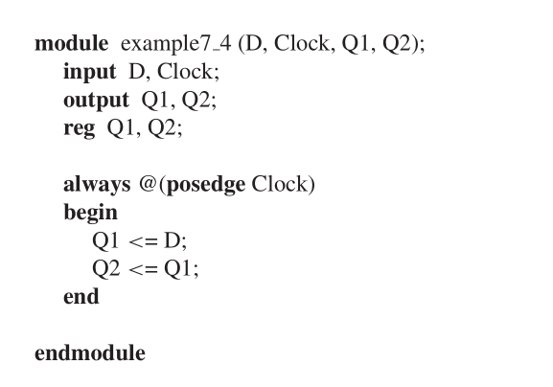
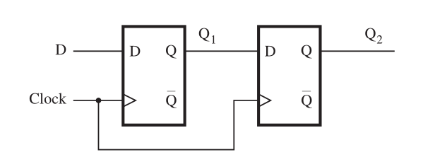
Procedural Assignment Statements

Slide 24
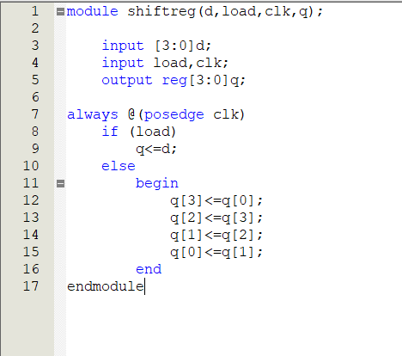
Procedural Assignment Statements
 | q[3] | q[2] | q[1] | q[0]
initial | 1 | 0 | 0 | 1
1st cycle | 1 | 1 | 0 | 0
2nd cycle | 0 | 1 | 1 | 0
3rd cycle | 0 | 0 | 1 | 1
4th cycle | 1 | 0 | 0 | 1

Slide 25
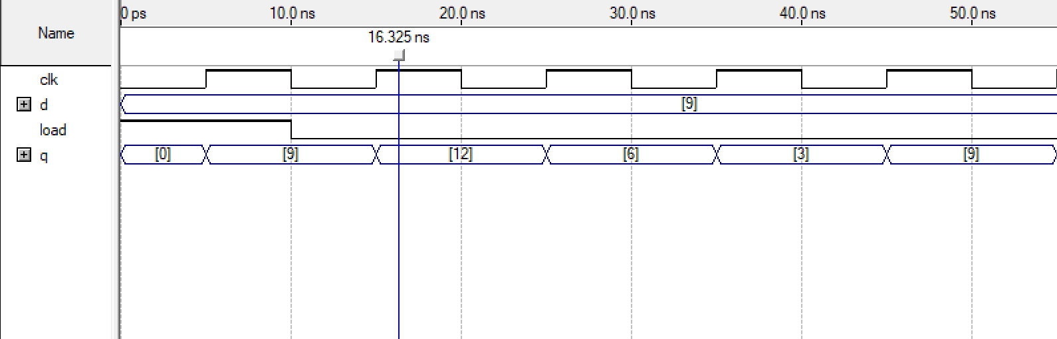
Procedural Assignment Statements (Non-Blocking)

Slide 26
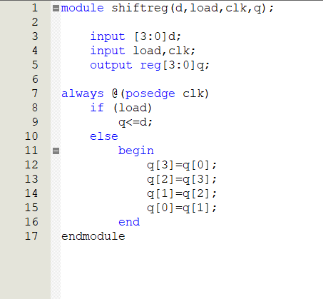
Procedural Assignment Statements
 | q[3] | q[2] | q[1] | q[0]
initial | 1 | 0 | 0 | 1
1st statement | 1 | 0 | 0 | 1
2nd statement | 1 | 1 | 0 | 1
3rd statement | 1 | 1 | 1 | 1
4th statement | 1 | 1 | 1 | 1
All of these happened within one cycle!

Slide 27
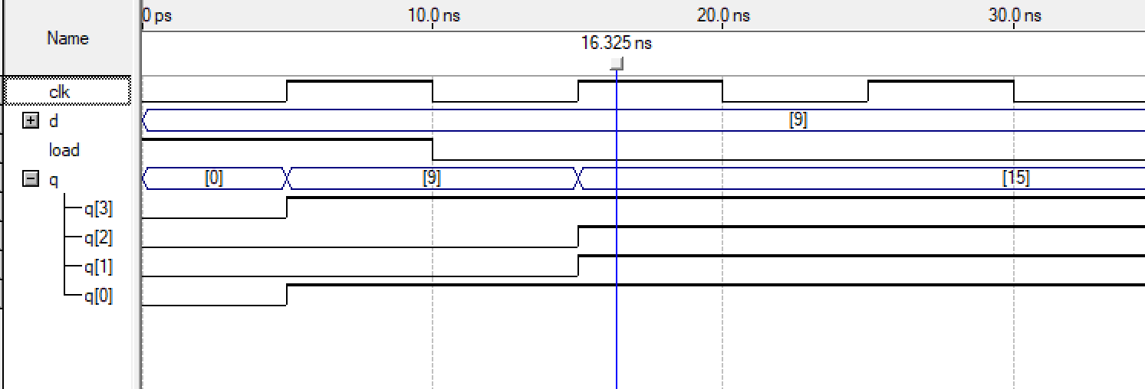
Procedural Assignment Statements (Blocking)

Slide 28
Thank you!

